Slide 1
Introduction to Parallel Programming with CUDA
GPU Device Shared and Constant Memory Investigation

Slide 2
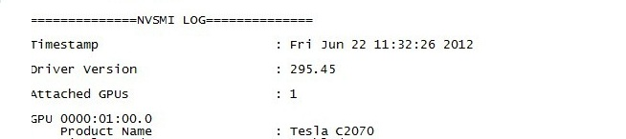
Reading the output of nvidia-smi
Attached GPUs – the number will often be 1 but if it is more you will need to loop through the GPUs identified below
GPU ID
Product Name : GPU Card Name
This is the value that you are going to look up to identify the specific GPU card parameters
[1]

Slide 3
Nvidia Architecture Tuning Guides
Kepler - https://docs.nvidia.com/cuda/kepler-tuning-guide/index.html
Maxwell - https://docs.nvidia.com/cuda/maxwell-tuning-guide/index.html
Pascal - https://docs.nvidia.com/cuda/pascal-tuning-guide/index.html
Volta - https://docs.nvidia.com/cuda/volta-tuning-guide/index.html
Turing - https://docs.nvidia.com/cuda/turing-tuning-guide/index.html
Ampere - https://docs.nvidia.com/cuda/ampere-tuning-guide/index.html

Slide 4
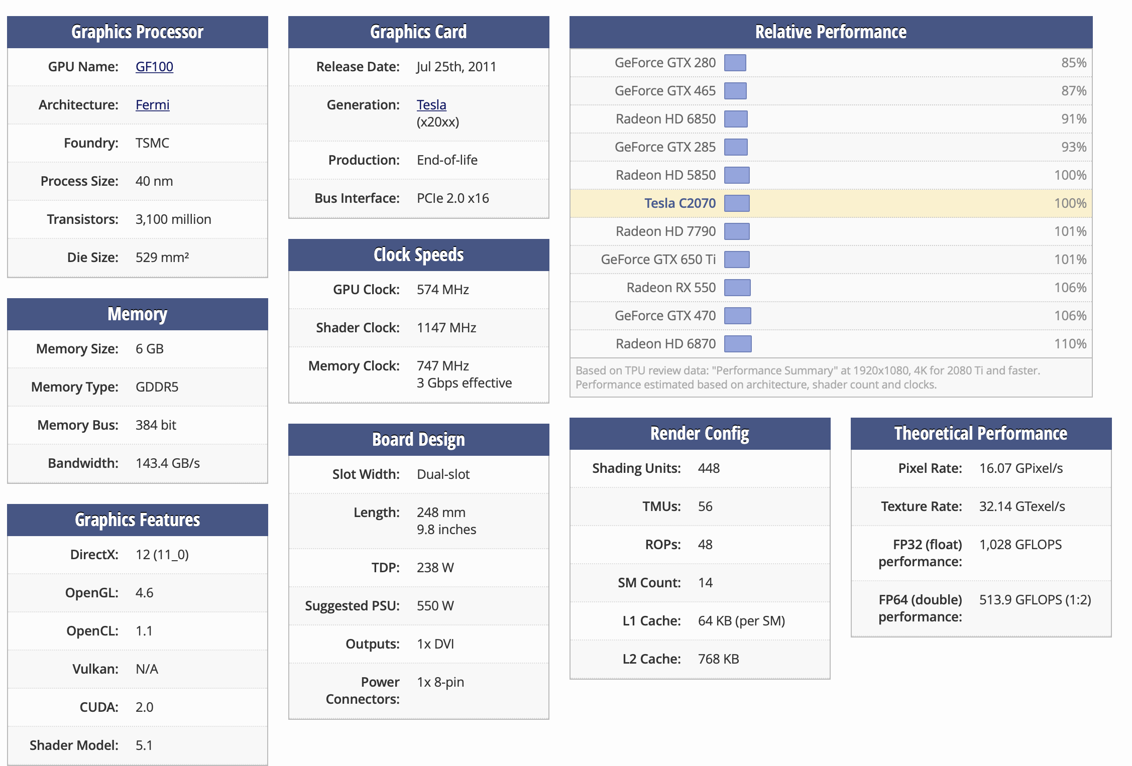
TechPowerUp GPU Database
Important Details:
Memory Size
CUDA
GPU Clock
SM Count
L1 Cache
L2 Cache
[3]

Slide 5
Bibliography
[1] 2020. Nvidia. Nvidia System Management Interface. Retrieved from https://developer.nvidia.com/nvidia-system-management-interface.
[2] 2021. Wikipedia: List of Nvidia graphics processing units. Retrieved from https://en.wikipedia.org/wiki/List_of_Nvidia_graphics_processing_units.
[3] 2021. TechPowerUp. Nvidia Tesla C2070. Retrieved from https://www.techpowerup.com/gpu-specs/tesla-c2070.c924

